Slide 1

{ "Success is not for the faint-hearted;
it belongs to those who dare to dream, persist,
and never give up.“ }
-CHATGPT

Slide 2


{ Time to Level Up!}
July 10th
Hosted by

Slide 3
Who am I?
Hey, I am Armaan.
-I like Chess,
-Pokémon.
-Coding,
-and M.U.N(s).

Slide 4
EX-MLH MENTOR
Flutter/Dart
Discord.py

Slide 5
Hackathons attended:- 13

Slide 6
Hackathons won:-9

Slide 7
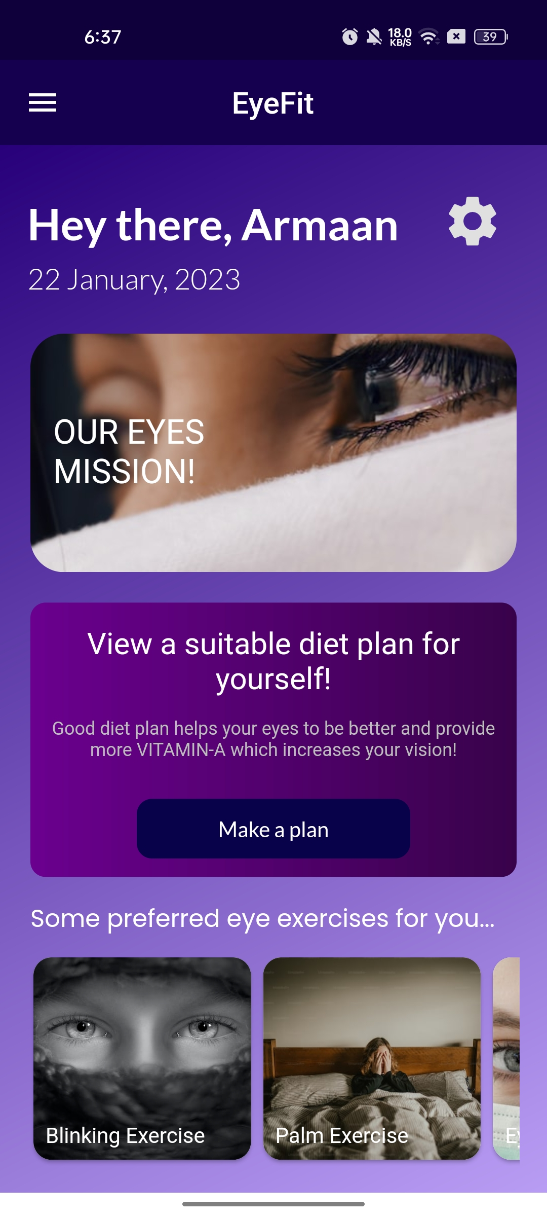
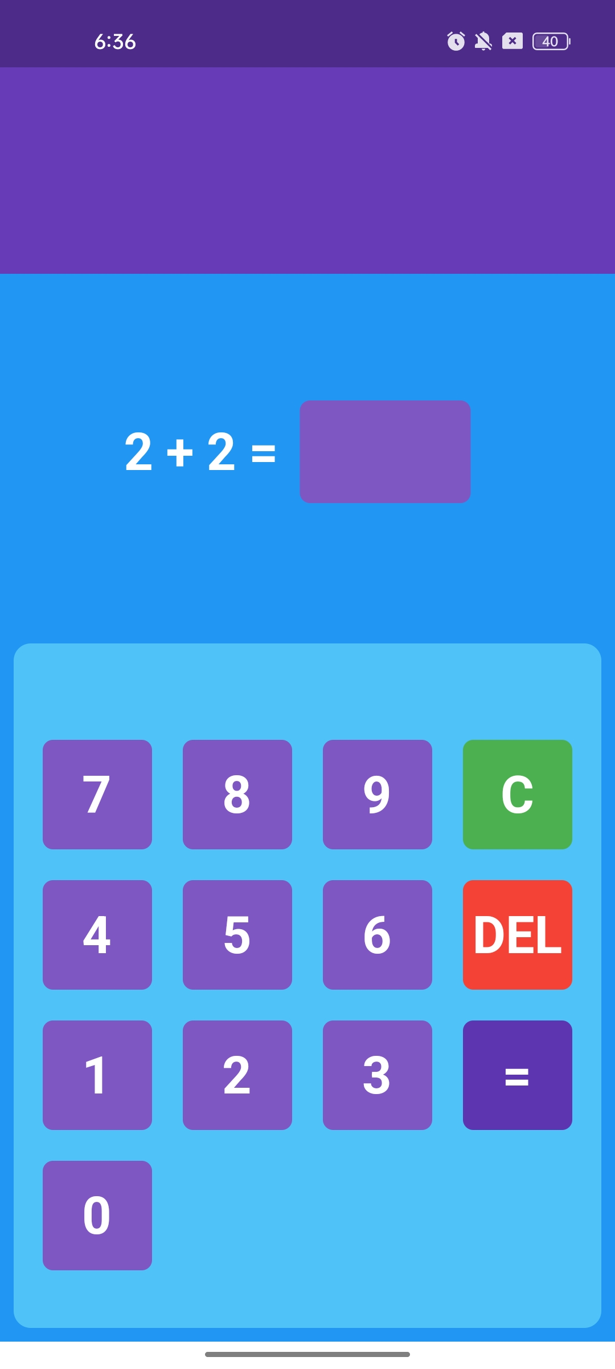
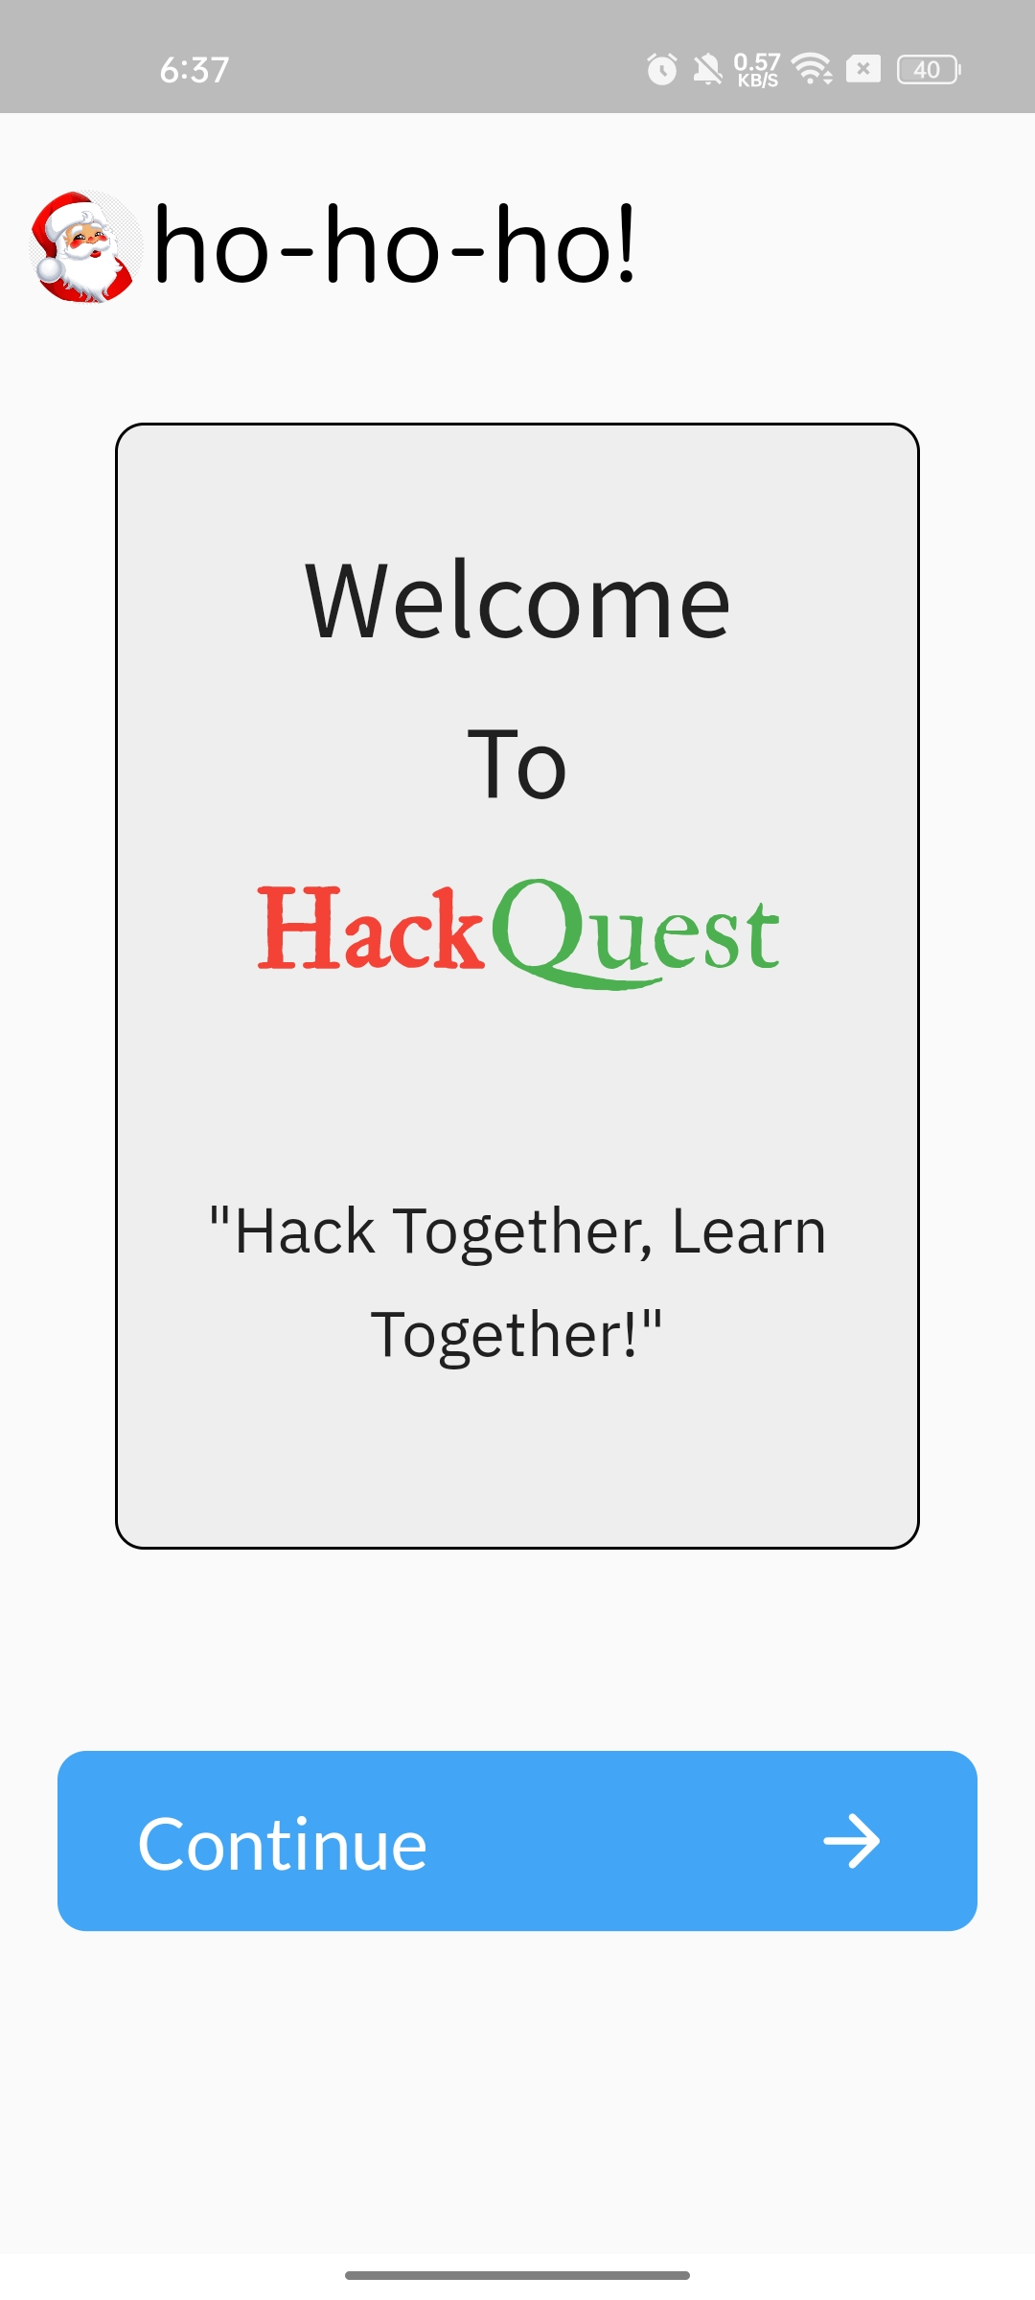

Slide 8
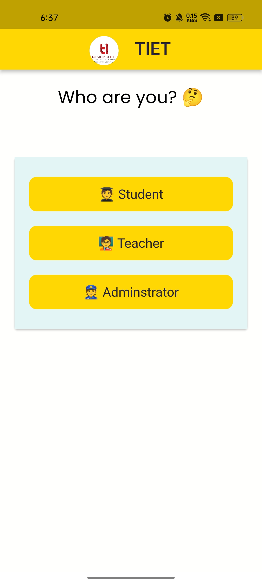
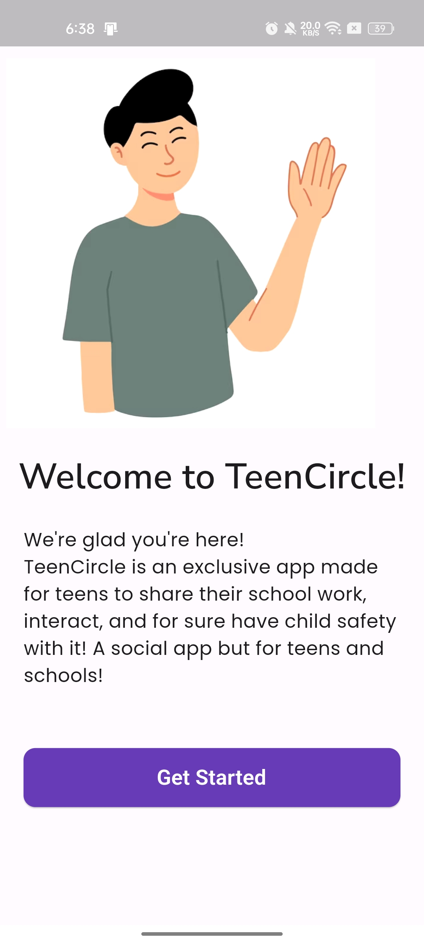
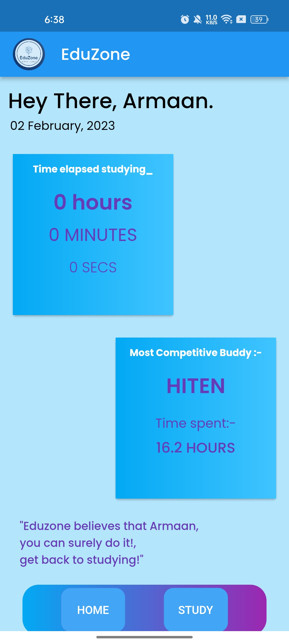

Slide 9




Slide 10


Slide 11
I am really excited for this session!

Slide 12
We will be learning, a lot of things today.

Slide 13
Important Links!

Slide 14
https://github.com/0Armaan025
@Armaan25#1078 for discord
https://chess.com/play/GM_ARMAAN

Slide 15
Questions? General Talks? Feedbacks?

Slide 16
Discord:- @Armaan25#1078
Email:- armaan33000@gmail.com

Slide 17
Let’s get started!

Slide 18

Flutter !!

Slide 19

Hackathons !!

Slide 20

Talking about communities/discord and making a basic discord bot.

Slide 21
Polling system
Hi System
Shop/Store system using embeds

Slide 22
Here comes a challenge:-
Make a discord bot which says Hi, if you say “Hello”, Hello if you say “Hi”, and “bye”, if you say “hlo”, to submit this project, go to projects-showcase section under the 30 days of coding challenge.
Worth: 50 points!!! 🔥

Slide 23
Chesss!!! https://chess.com/play/GM_ARMAAN

Slide 24
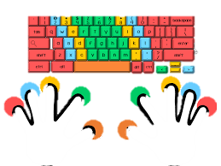
Typing time!

Slide 25
Before ending, there’s something left…

Slide 26


CodeBeetles says:- Scan me!

Slide 27

MLH says:- Scan me!

Slide 28

Chessscape says:- Scan me!

Slide 29
Thank you!! ☺

Slide 30
